Slide 1
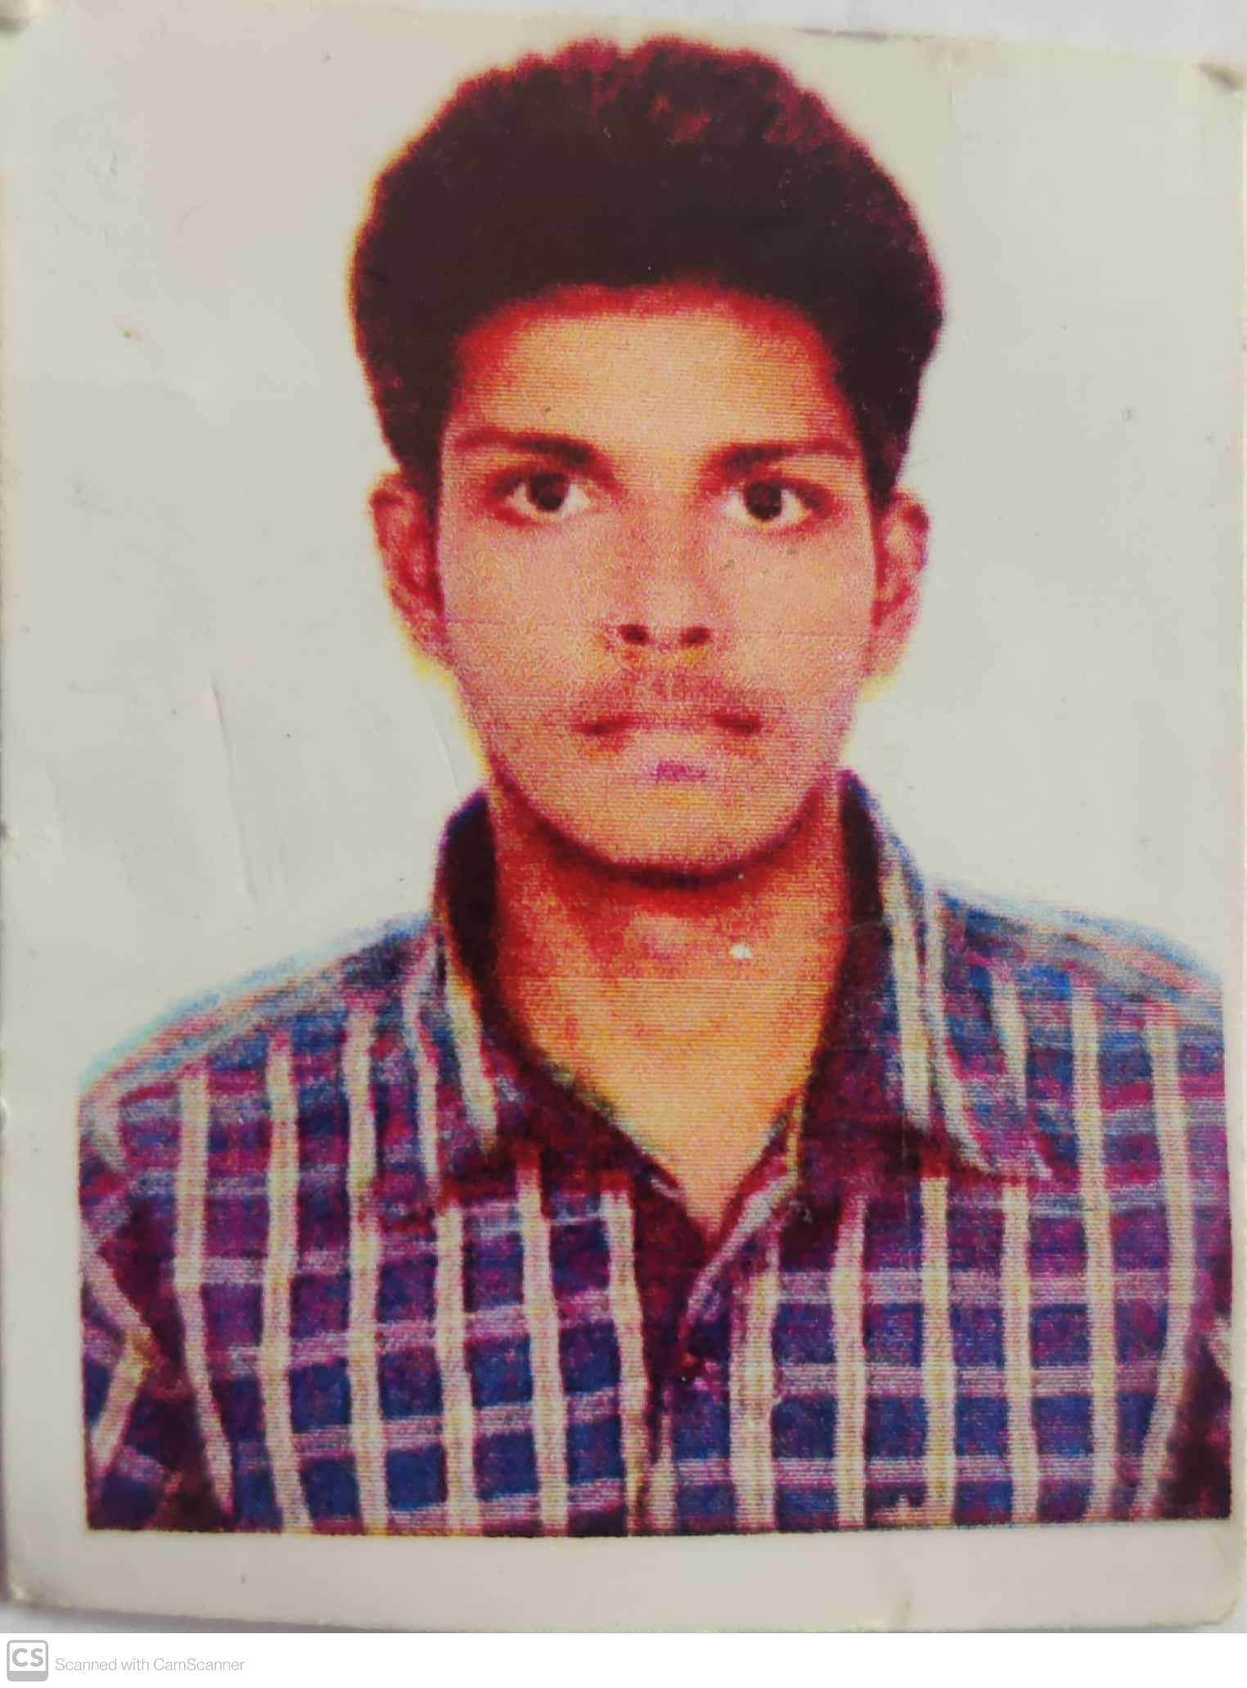

JIJJAVARAPU JAYA SAI SRINIVAS
Analyst/Software Engineer
Master of Computer Application
: 2017 - 2020
Skills
Bangalore
C# | C#Basics, OOPS, Generics, Collections, Arrays.
.NET | ADO.NET,ASP.NET with MVC5 and WEB API, Entity Framework
Version Control Tool | Git, GitHub, Branches, Merging
Angular | Components, Services, Modules, Routing, Forms & Validation.
UI | HTML 5 & CSS 3,JavaScript, ES6 & TypeScript ,Bootstrap
Dtabase | Microsoft sql server
Tools | Git, SSMS, Visual Studio, Visual Studio Code
Add On Skills | Self Learning
Jijjavarapu.jaya-sai-srinivas@capgemini.com
+91 8008765626
A4
Full Stack Developer
Hands on experience on C#,ADO.NET, LINQ, Entity framework, Sql Server, ASP.NET MVC5 with WEB API
Knowledge on creating Single page Web Application in Angular .
Knowledge on creating databases in SSMS
Having Knowledge on Git And GitHub
Online Hotel Management System
Case study of Online Hotel Management System along with API Gateway, Swagger, and payment , responsive UI with HTML5, CSS, Bootstrap and Angular used as User Interface.
Degreed :
Successfully completed the degreed training in git,html,css, sql C#, .Net Core, Angular.
Check out my work on GitHub

